Slide 1



My Notes
Group G3

Slide 2



Presented by:
Hridayesh Pariyar
Chirag Jethwa
Bhavya Patel
Anshu Pandey
Samit Chhetri
Bimal Shrestha
Arjun Sahani

Slide 3


Introduction

Slide 4


Introduction
We are thrilled to present to you the next generation of note-taking-apps. In today's fast-paced world, information flows seamlessly, and capturing essential details efficiently has become more critical than ever. Whether you're a student, a professional, or a creative mind, having an effective note-taking tool is essential for staying organized, and boosting productivity.

Slide 5


Why this project?

Slide 6

Why?
OUR STORY
BACKGROUND
Our journey started with a simple observation - traditional note-taking methods were disorganized and complex. As avid learners and professionals, this inspired us to create a platform that would bridge the gap between conventional note-taking and the evolving needs of modern users.
Experienced in web development, user interface, and educational research form the core of our team. We deeply understand user needs through extensive research, driving our commitment to create a transformative note-taking platform. Trust in our background empowers us to deliver a great note-taking experience tailored to you.

Slide 7



How it works?

Slide 8

Functions
CREATE.
READ.
Create a note, enter data, hit okay and the note is ready.
Read any of the note on a single click on home page.
EDIT.
DELETE.
User can make changes as per his/her choice in any of the notes.
User can also delete the unwanted notes to clear up the space.

Slide 9
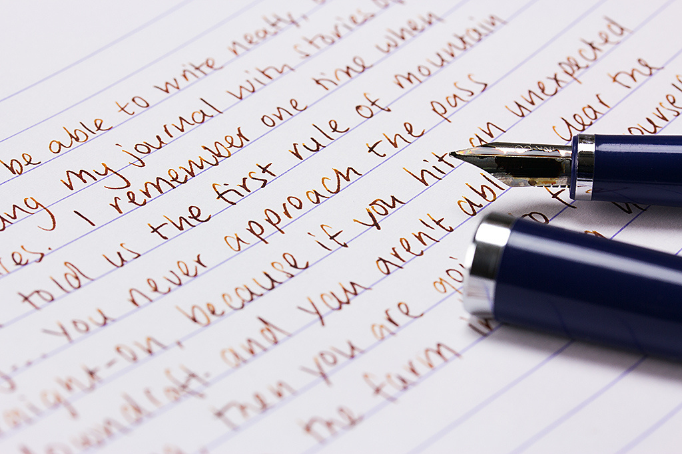
Values
RESPONSIVE
Responsive design enables users to access our website in any electronic device.
MINIMALISTIC
Our minimalistic approach to the website showcases our understanding of modern users.

Slide 10
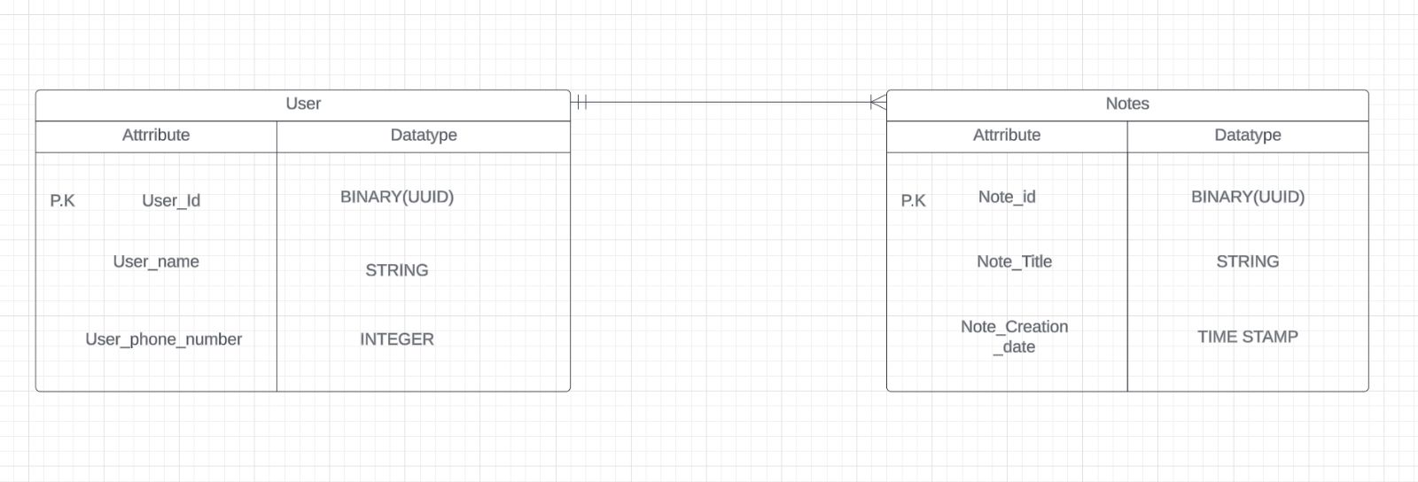
ER DIAGRAM

Slide 11
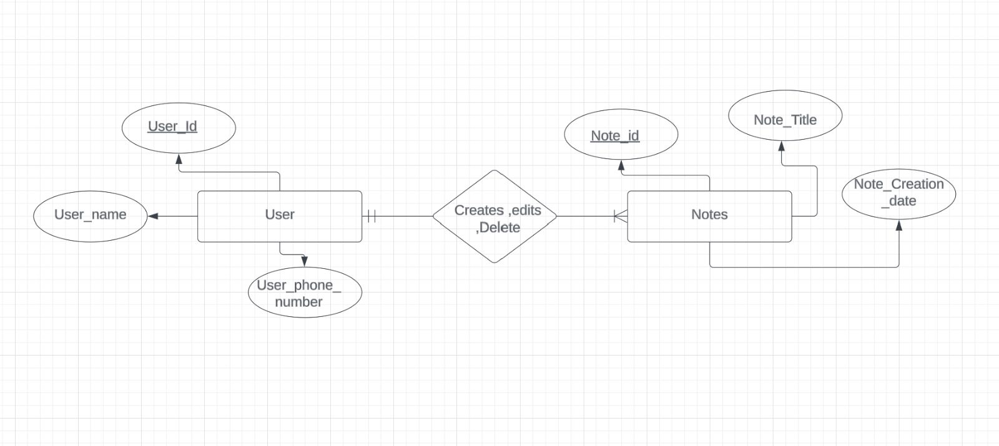
ER DIAGRAM

Slide 12
Screenshots

Slide 13
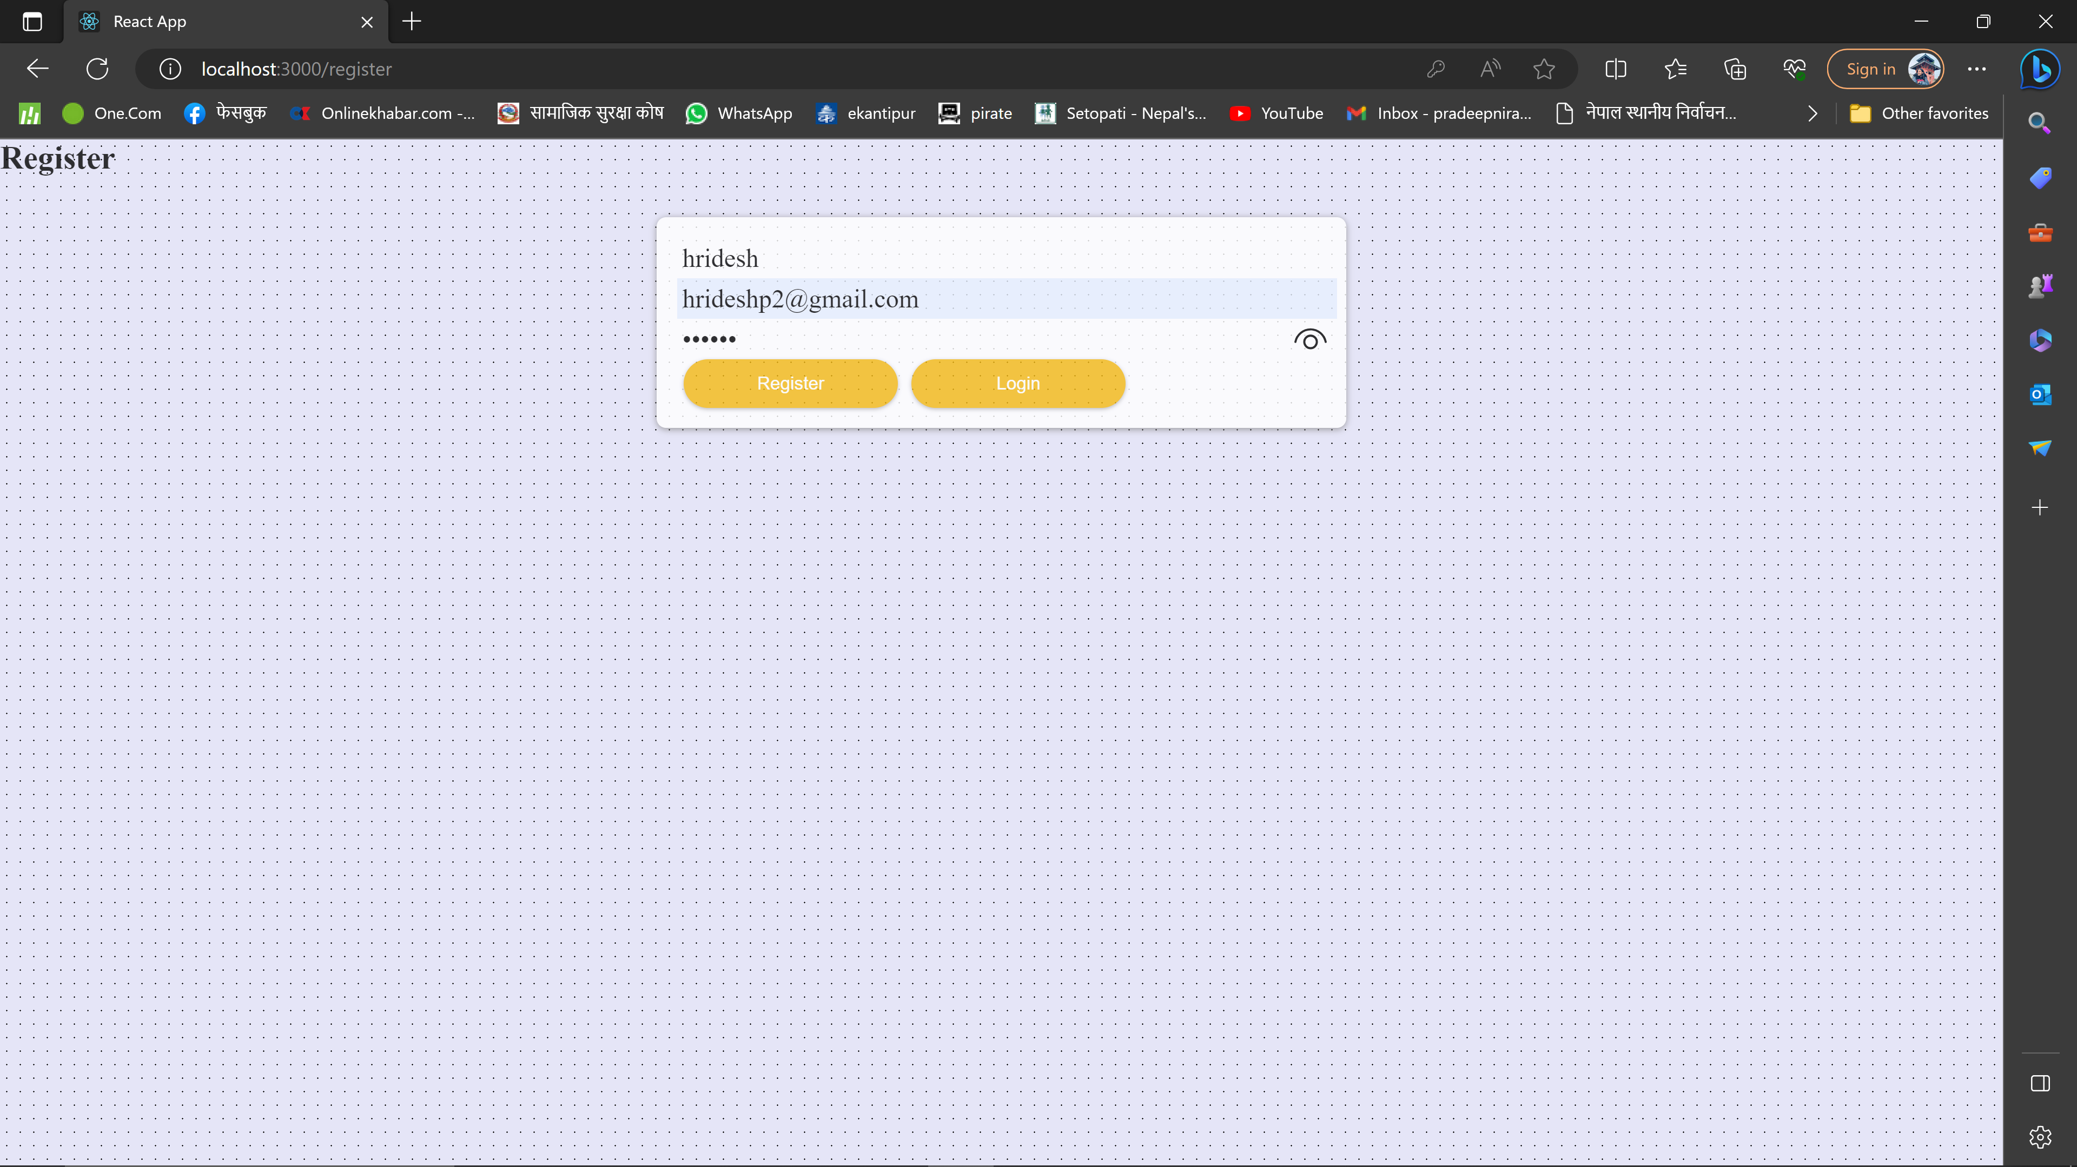
Register Page

Slide 14
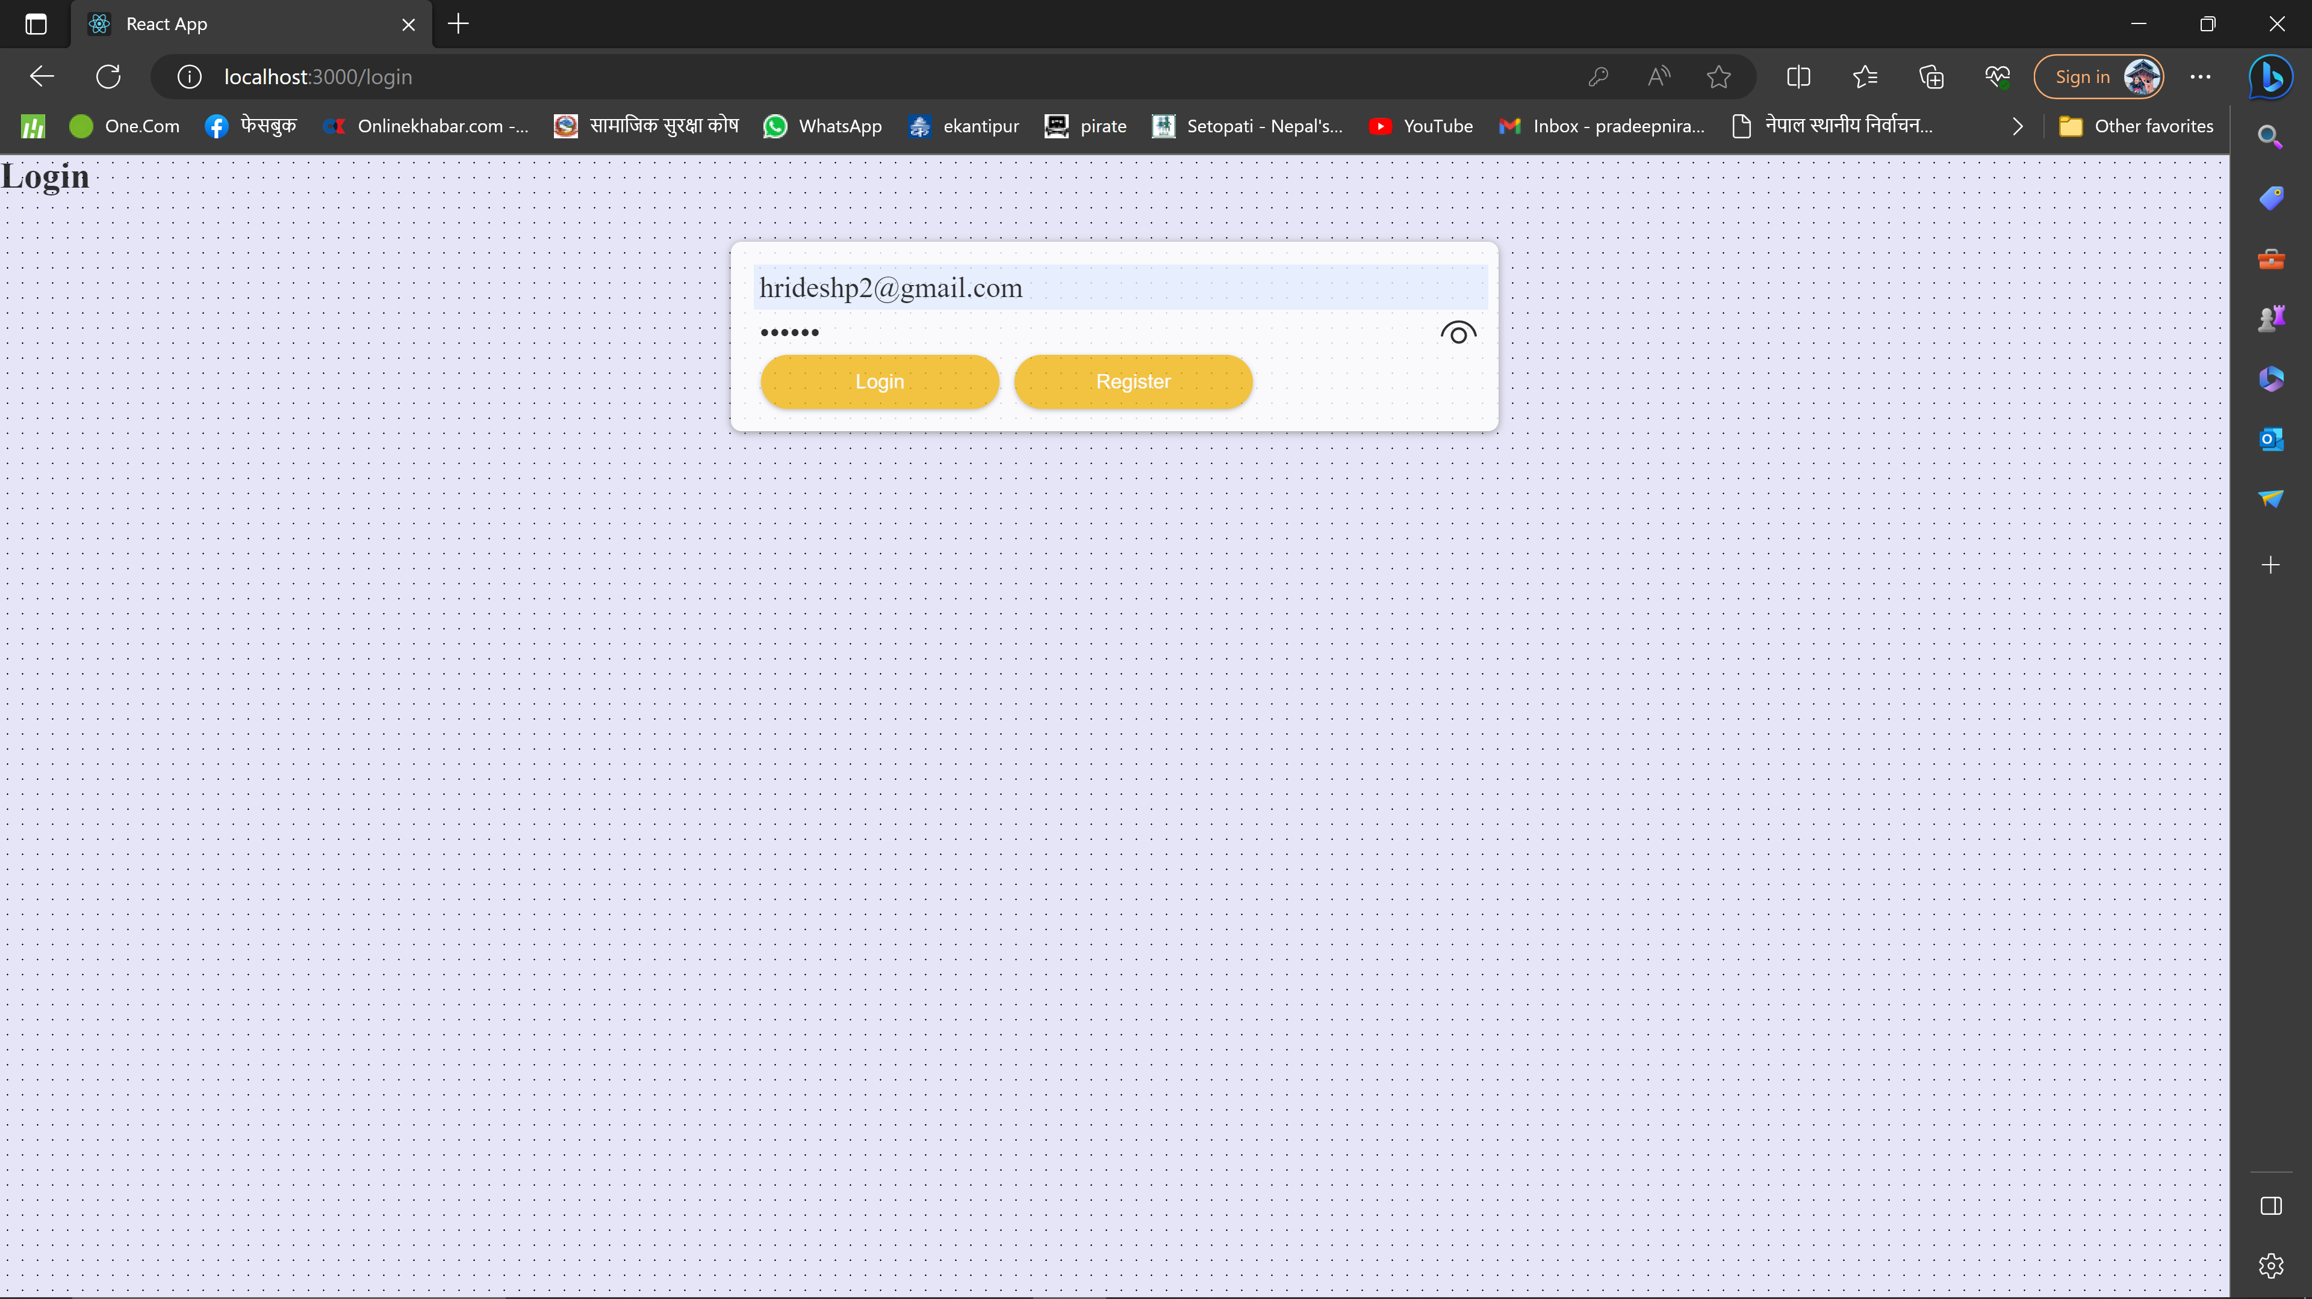
Login Page

Slide 15
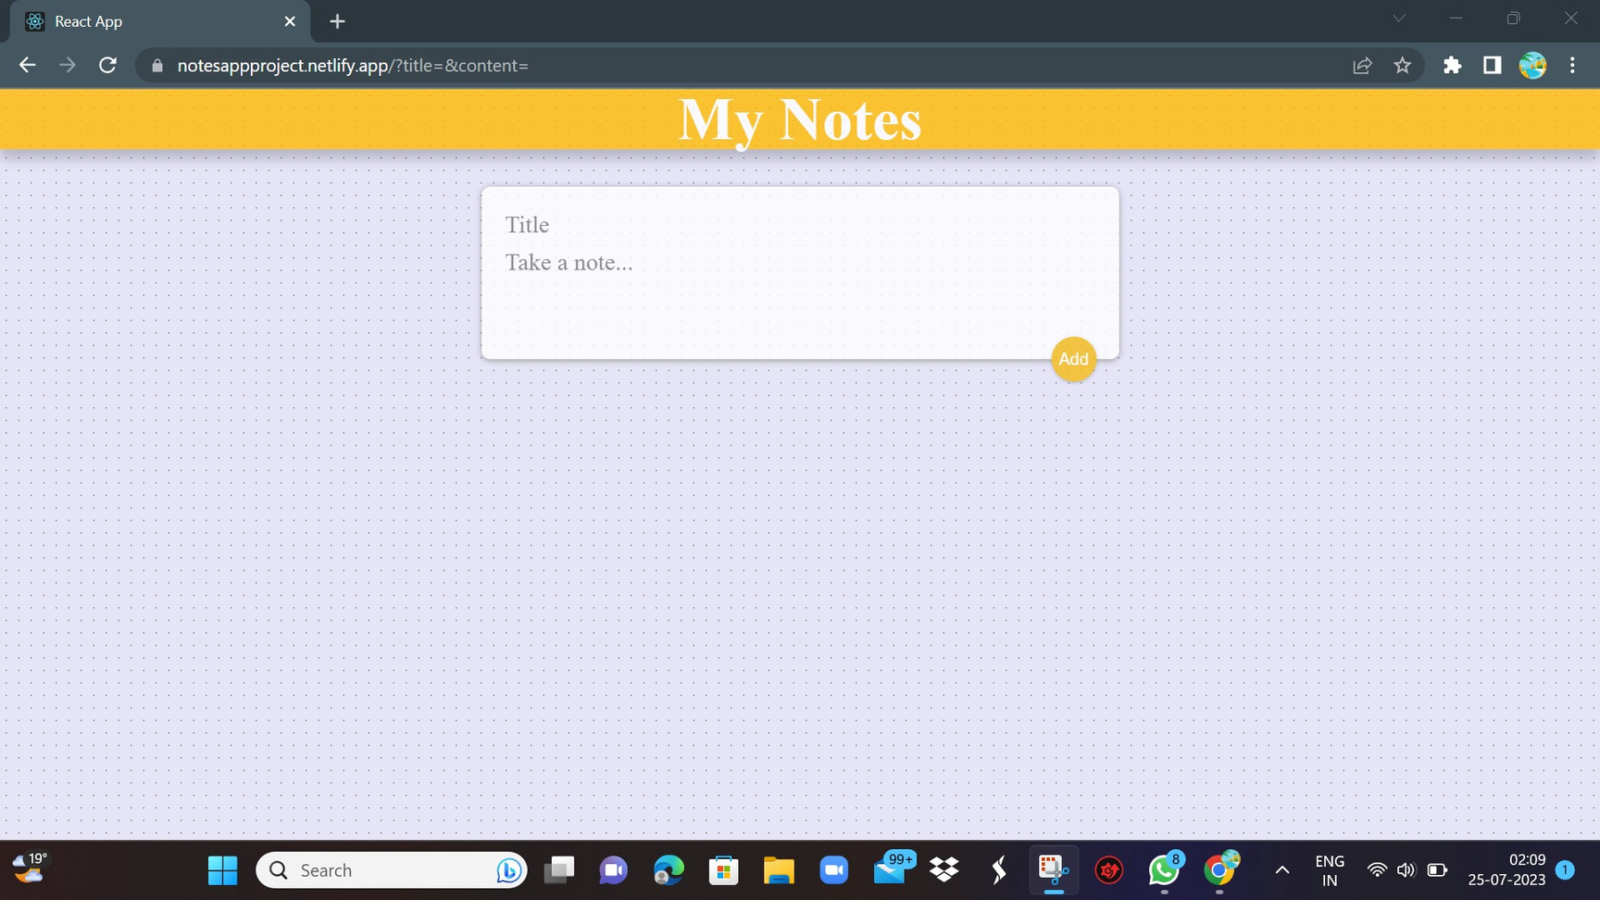
Home Page

Slide 16
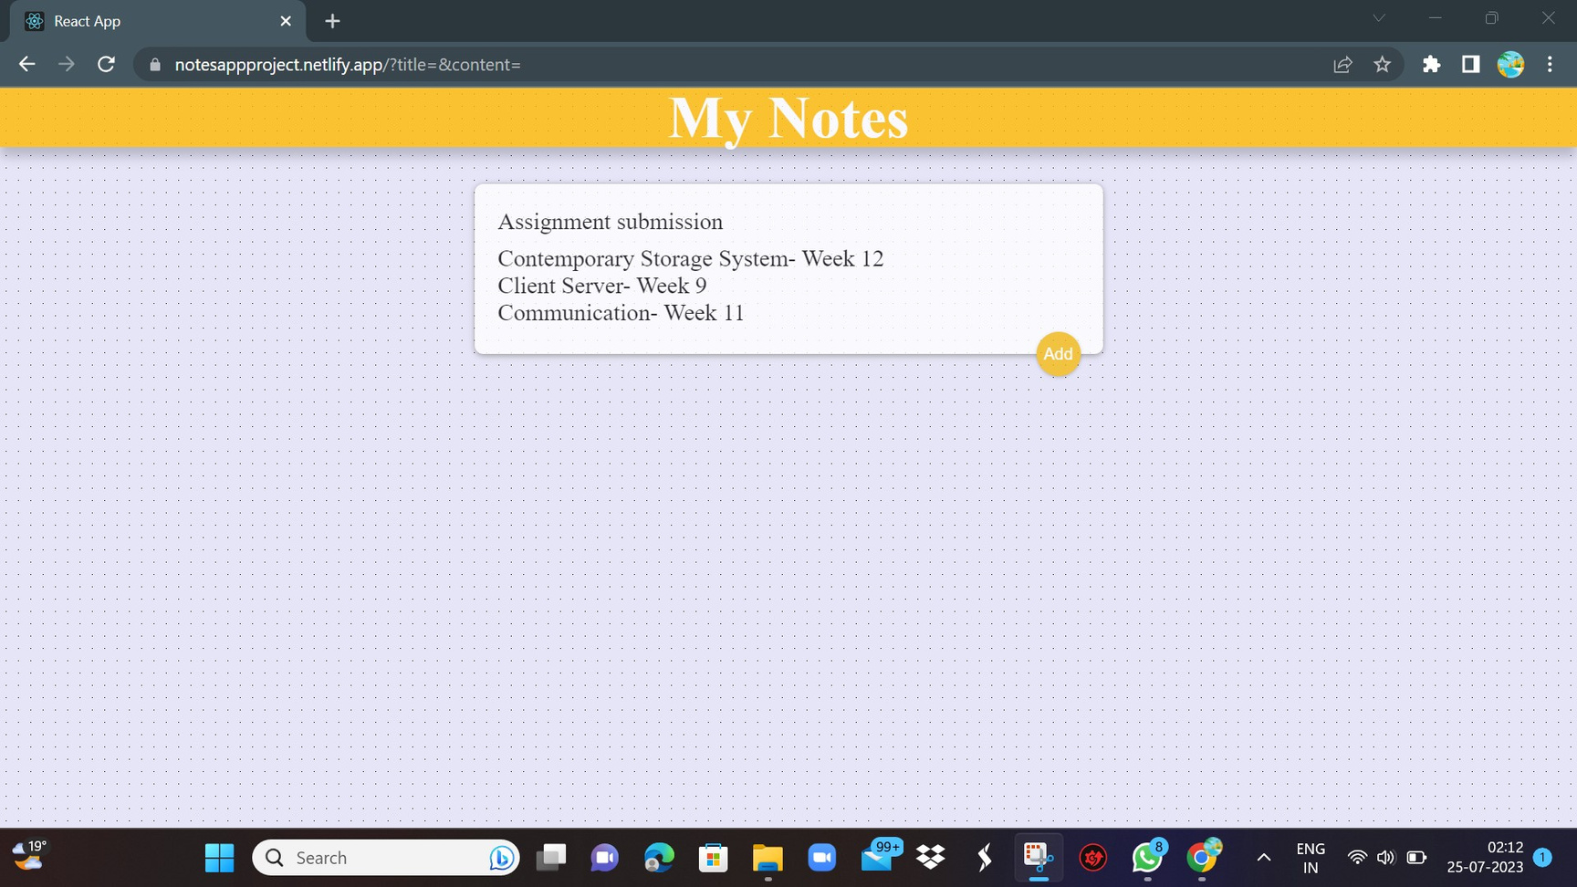
Create Note

Slide 17
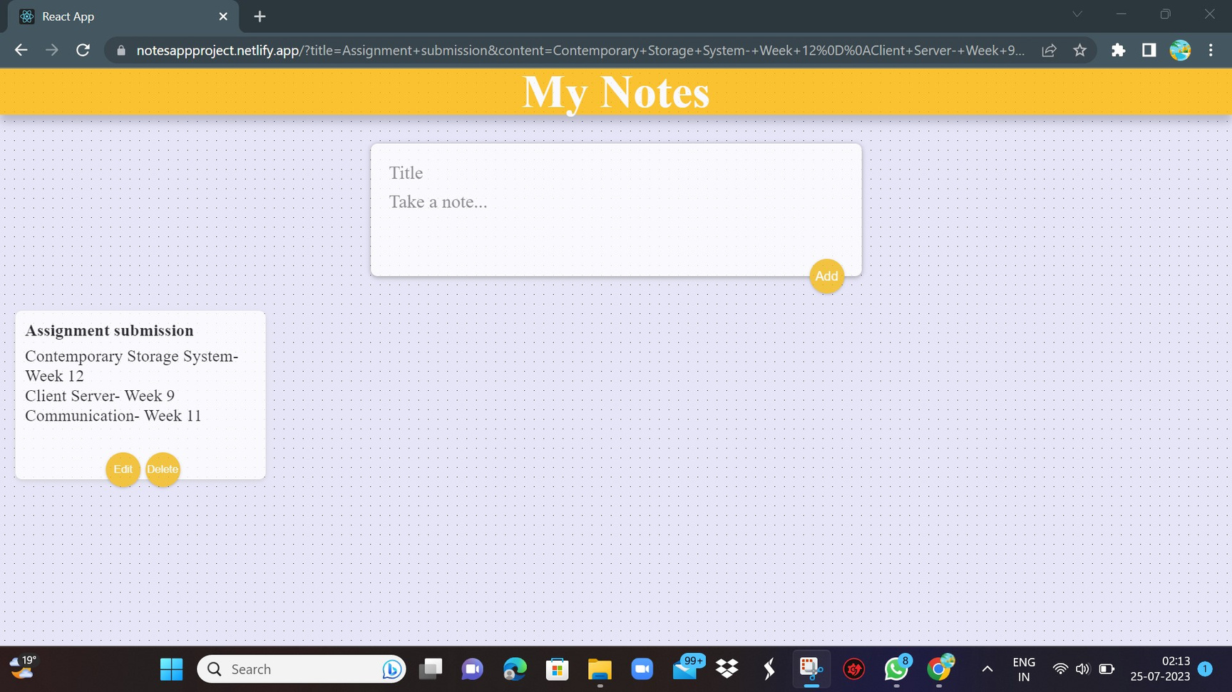
Note Created

Slide 18
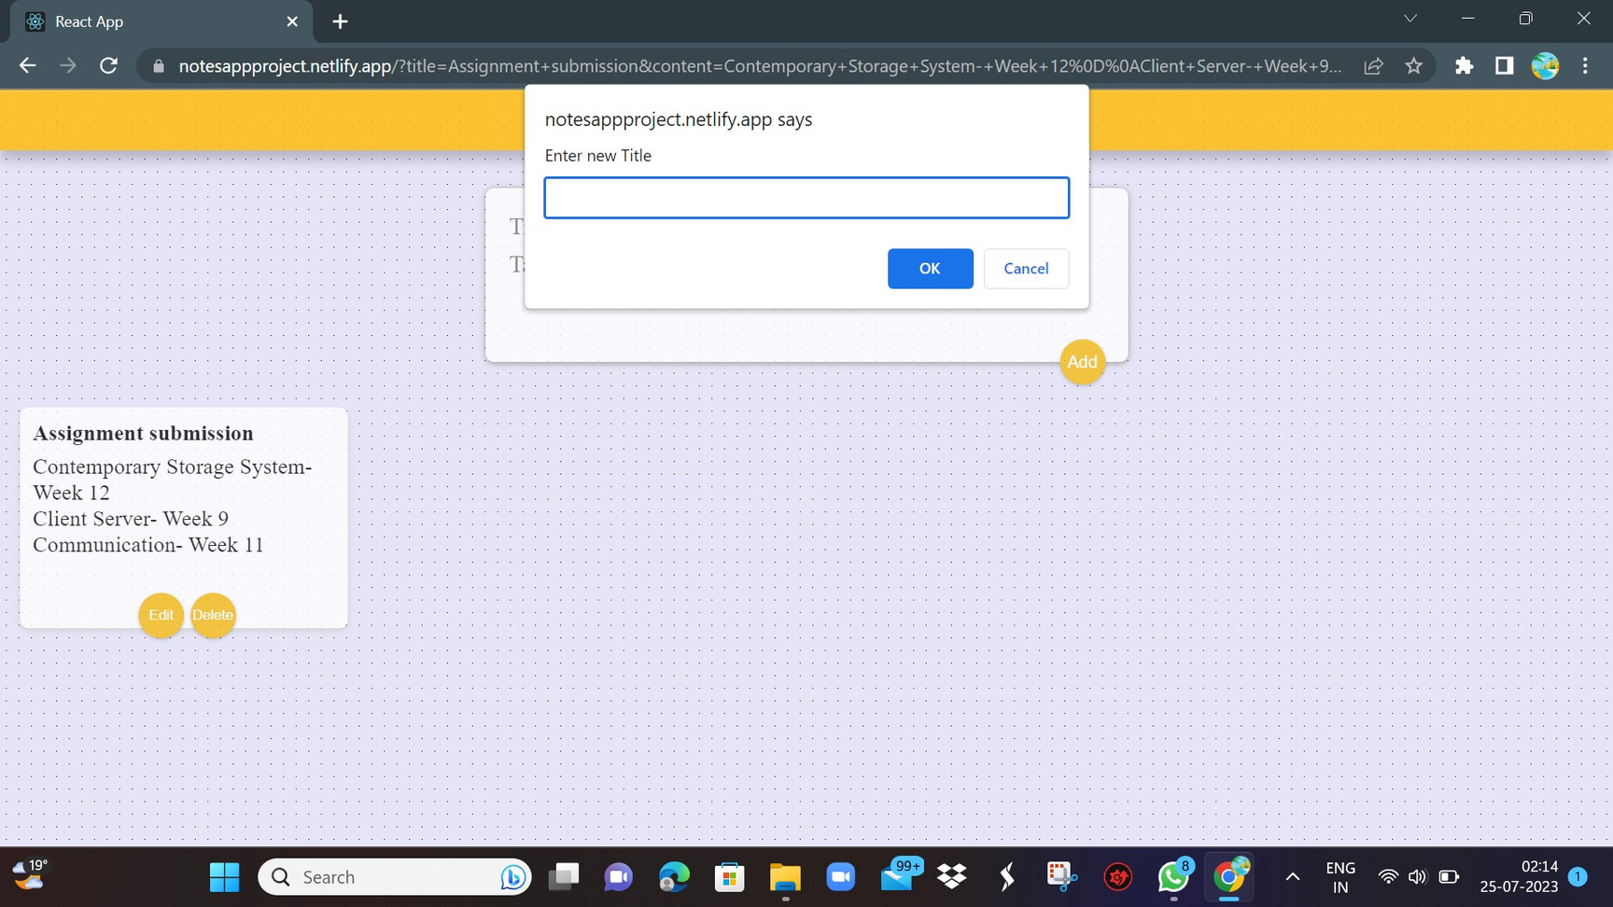
Edit note

Slide 19

Edit Title

Slide 20
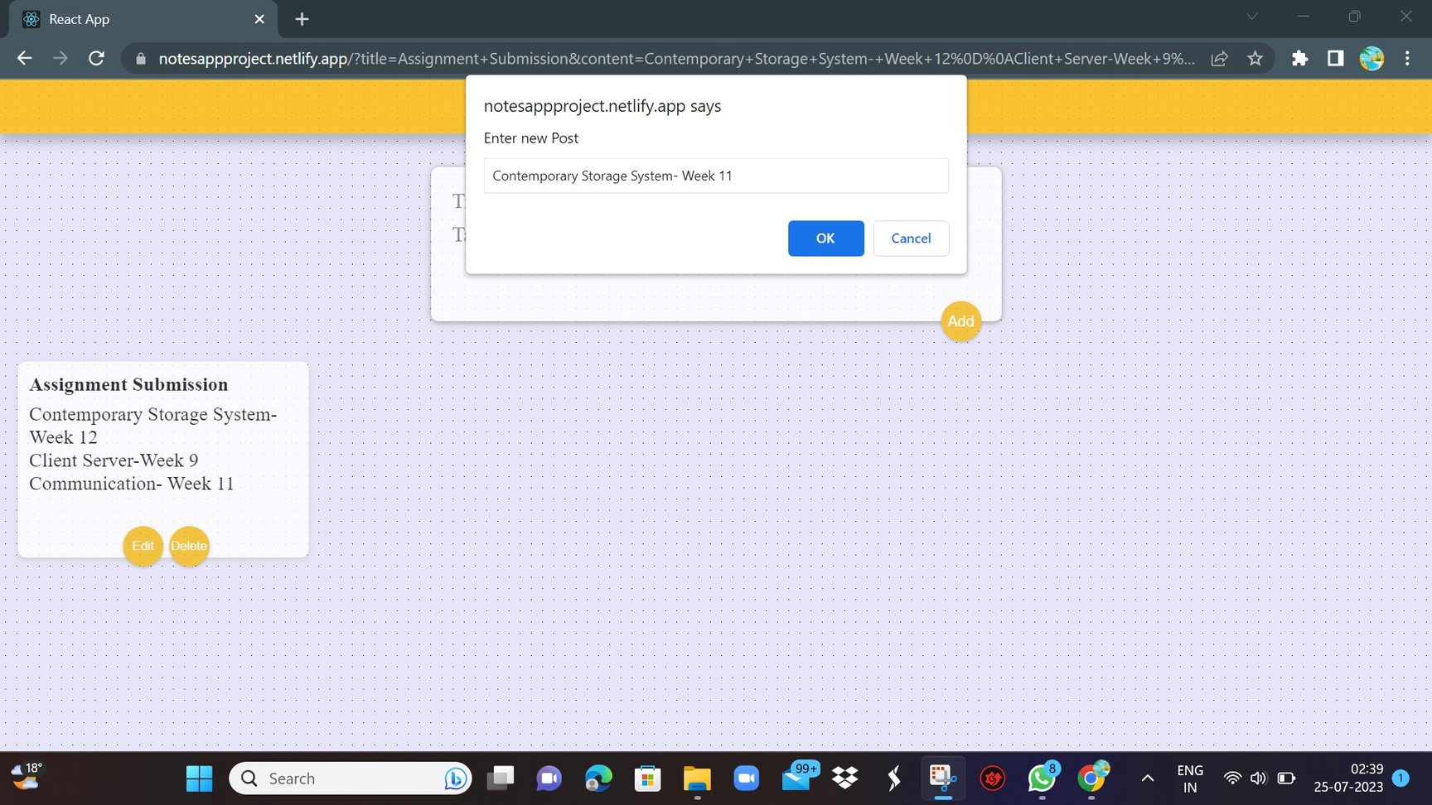
Edit Content

Slide 21
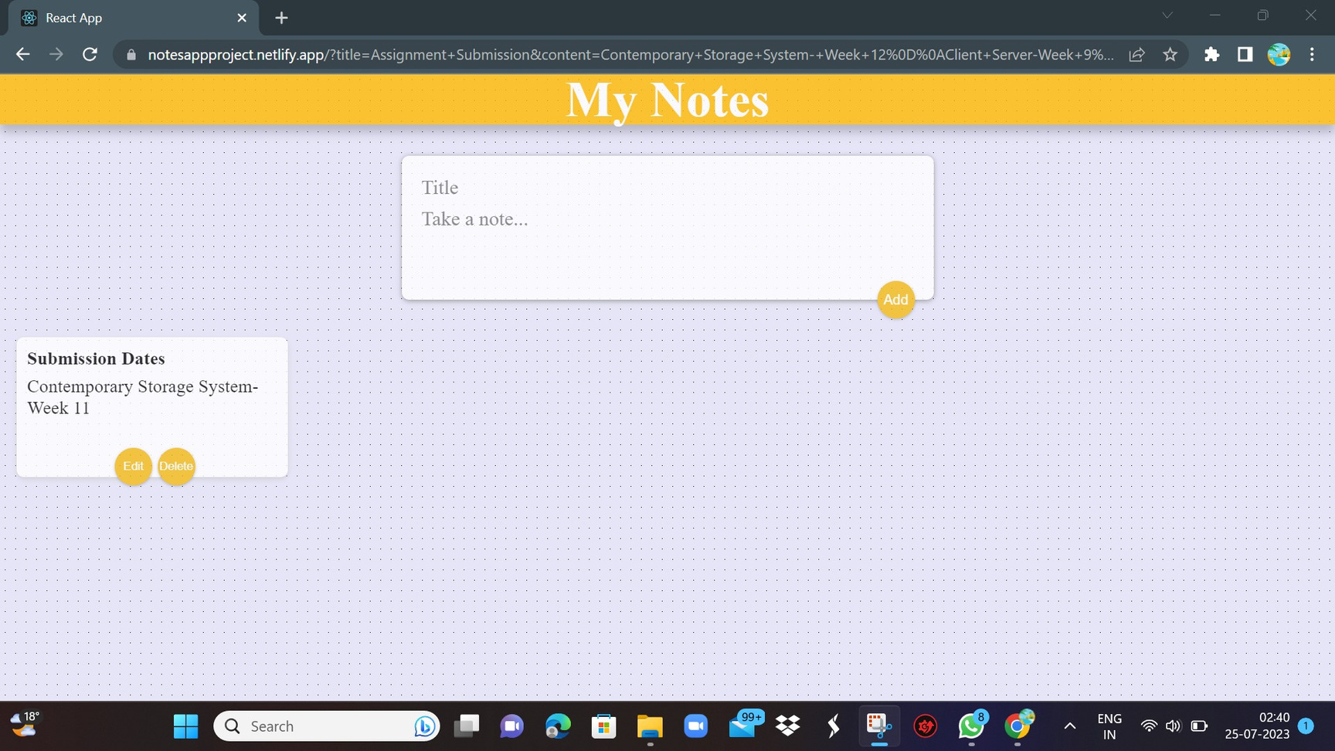
Note Edited

Slide 22

Note Deleted

Slide 23
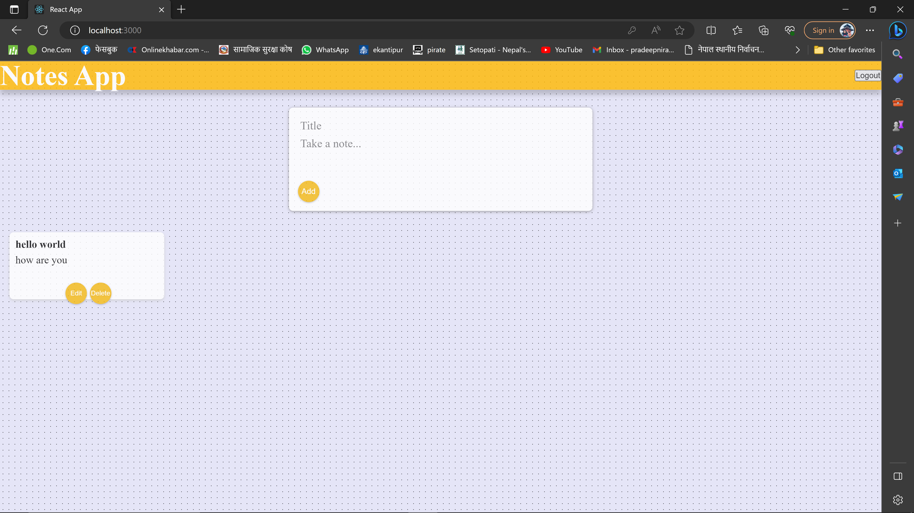
LogOut Page

Slide 24
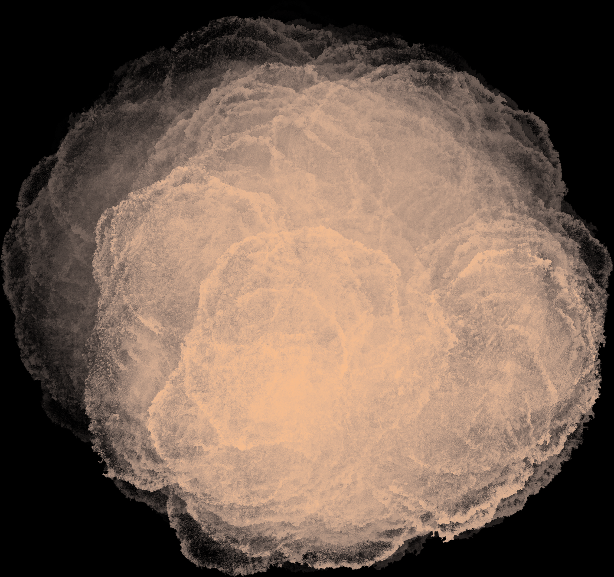
Thank
you

